Slide 1
Student Documentation via Whatsapp
Presenter: Linda Putu

Slide 2
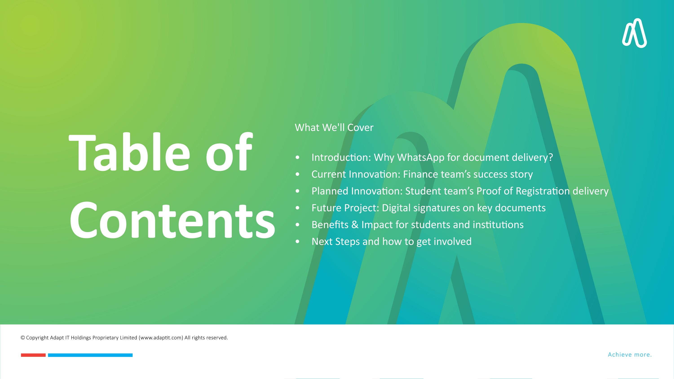
What We'll Cover
Introduction: Why WhatsApp for document delivery?
Current Innovation: Finance team’s success story
Planned Innovation: Student team’s Proof of Registration delivery
Future Project: Digital signatures on key documents
Benefits & Impact for students and institutions
Next Steps and how to get involved

Slide 3
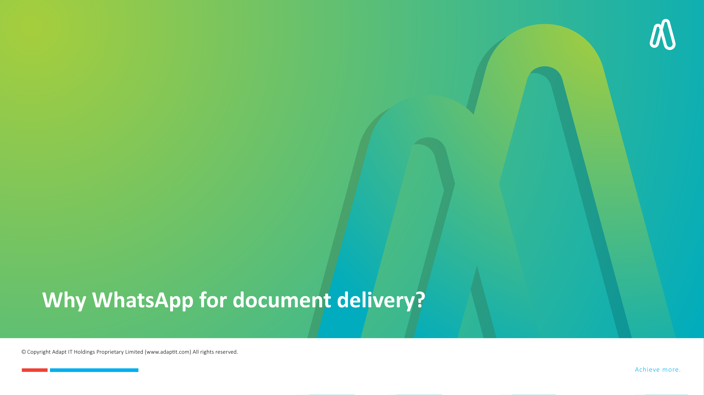
Why WhatsApp for document delivery?

Slide 4
Why WhatsApp?
Fast, secure, and convenient access to student documents
Reduces administrative workload
Enhances communication and student satisfaction

Slide 5
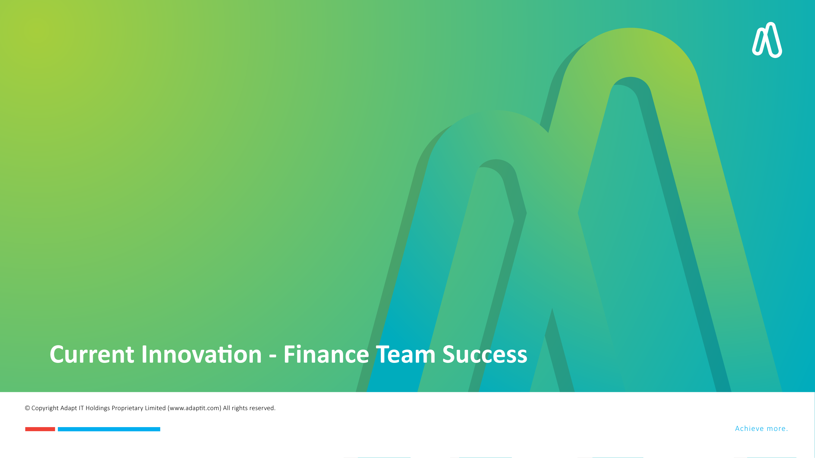
Current Innovation - Finance Team Success

Slide 6



ITS Seamless Integration with CUEDESK
Using CUEDESK as the distributor, we implemented a solution that generates and sends student statements via WhatsApp.
A secure integration with the ITS system, protected by token-based authentication, ensures a seamless and reliable data transfer between the two platforms.

Slide 7
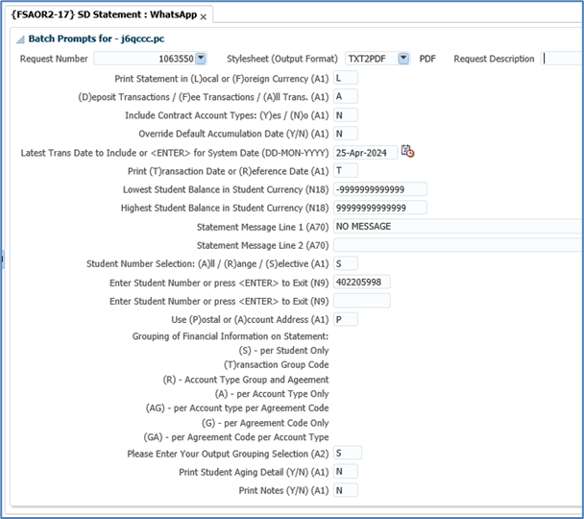
Sending statement via WhatsApp

Slide 8
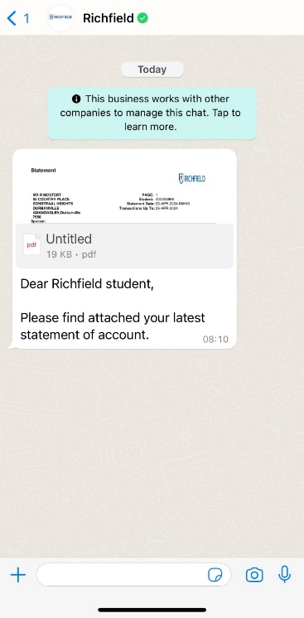
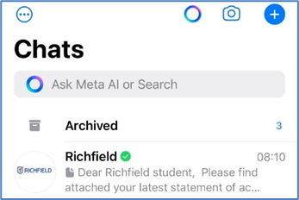
Sending statement via WhatsApp

Slide 9
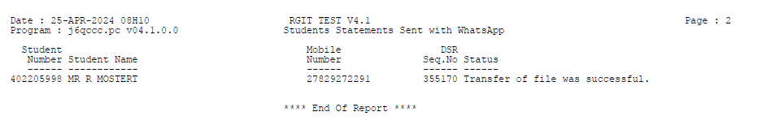
Sending statement via WhatsApp

Slide 10
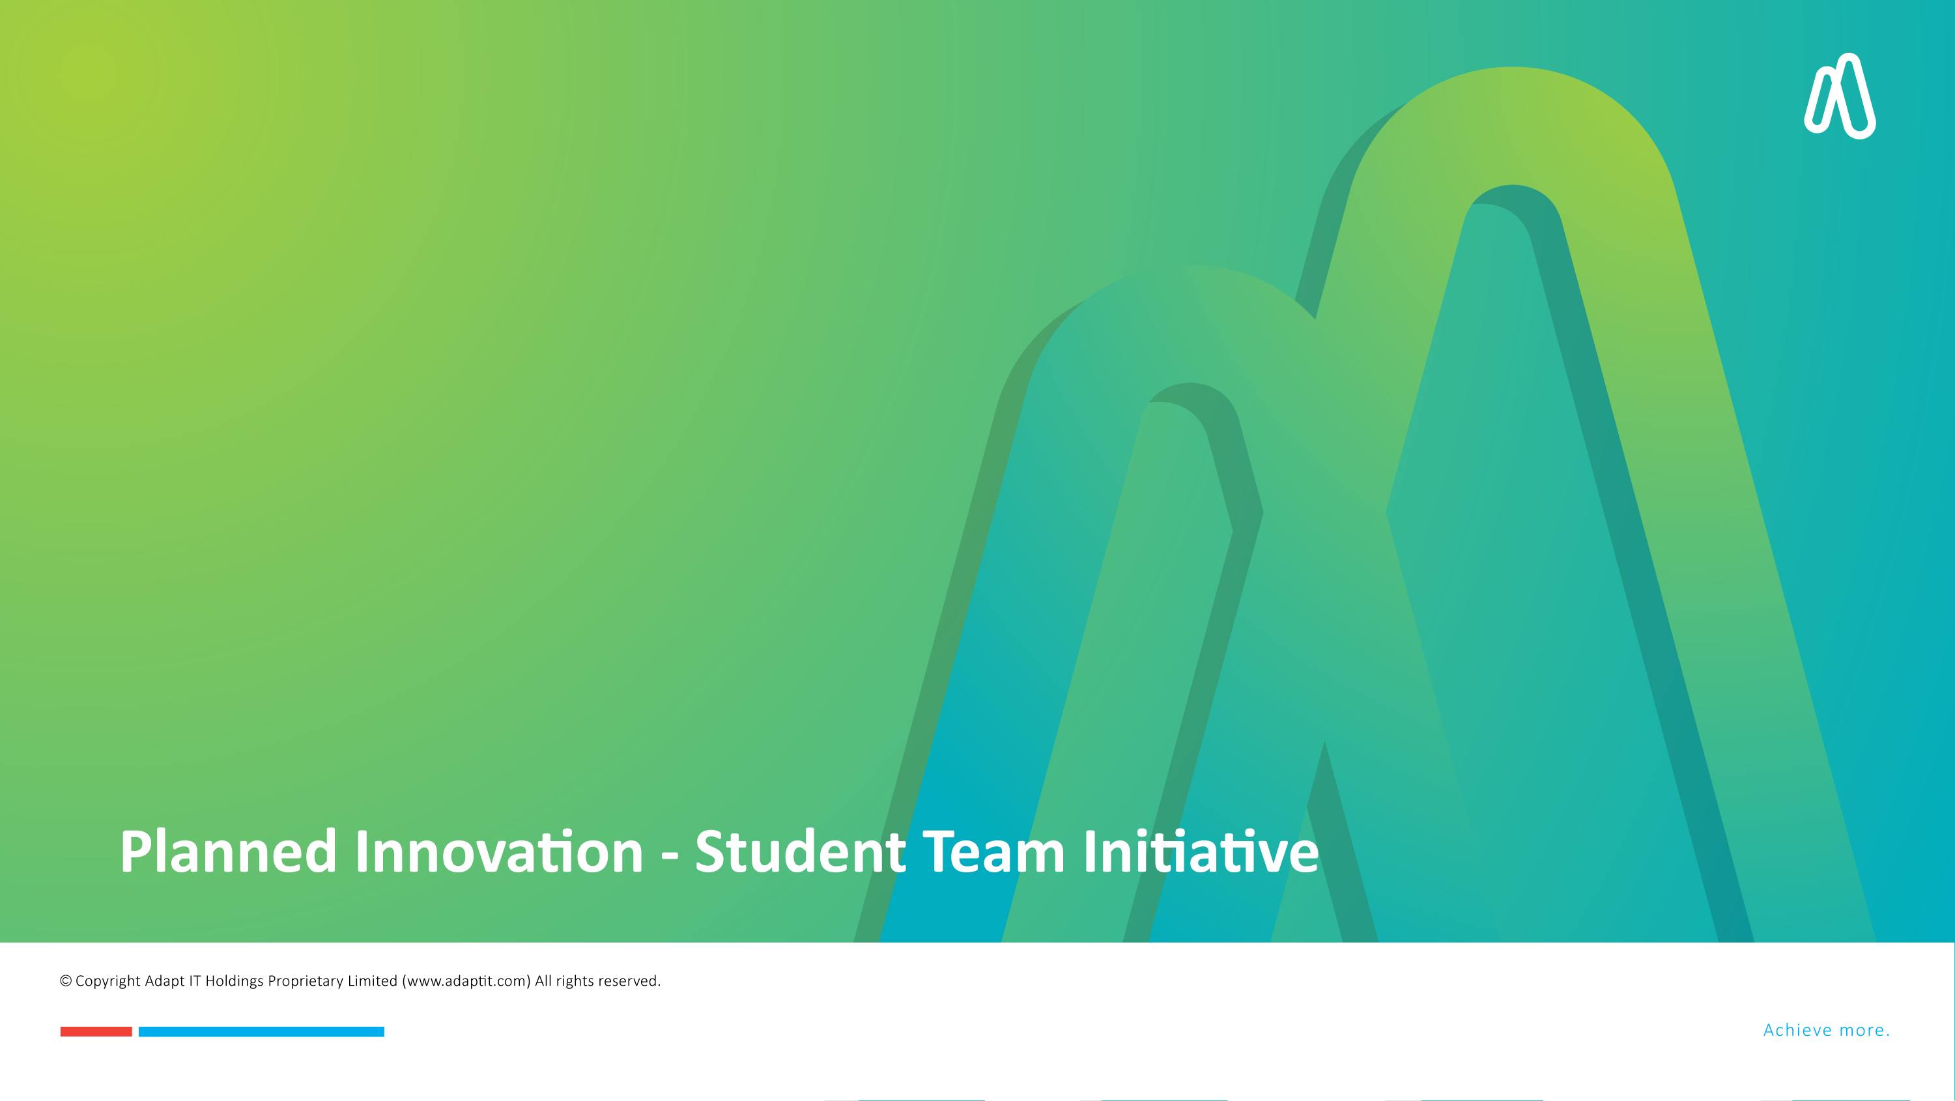
Planned Innovation - Student Team Initiative

Slide 11
WhatsApp Delivery: Proof of Registration
Goal: Enable students to receive their Proof of Registration instantly via WhatsApp.
Approach: Leverage the existing process successfully implemented by the finance team.
Current Status & Data:
  Solution Readiness: 100% of the technical framework is complete.
  Projected Rollout Time: Approximately 2 weeks post-customer onboarding.
  Expected Usage: Based on the finance team's adoption rates, students are expected to use WhatsApp for document access.
  Efficiency Gains: Potential alternative that could increase the student journey value
  Response Time: Students will receive documents within 30 seconds of request.

Slide 12

Planned Innovation - Student Team Initiative

Slide 13
Vision for Digital Signatures
Adapt IT is committed to modernizing student document workflows by introducing digital signatures.
The goal is to enable students and institutions to sign documents securely and digitally, reducing the need for physical signatures and paperwork.

Slide 14
Key Documents for Digital Signatures
Student Proof of Registration
Digital signatures will authenticate registration documents, ensuring they are legally valid and securely stored.
Academic Transcripts (Bulk)
Allowing the bulk issuance of academic transcripts with verified digital signatures for authenticity, speeding up the process for students and institutions.
HDMS (Higher Diploma Management System)
Digital signatures on HDMS documents will improve workflow efficiency and reduce paperwork for graduate and higher diploma students.
Graduate Certificate
Enabling digital signatures on graduate certificates ensures quick validation and eliminates delays caused by traditional signature processes.
Institution Proof of Registration (Bulk)
Bulk registration proofs for institutions will be electronically signed, streamlining processes for large student bodies.
Student Proof of Residence
Ensuring that proof of residence documents are digitally signed and available in a secure, easily accessible format for students.
Institution Proof of Residence
Similar to student proof of residence, institutional documents will be digitally signed to reduce manual errors and enhance security.

Slide 15
Advantages of Digital Signatures
Efficiency: Documents will be signed and processed faster, improving turnaround times for students and administrative staff.
Security: Digital signatures are tamper-proof and are verified by trusted certificate authorities, enhancing document integrity.
Cost-Effective: Reduces paper usage, printing costs, and the time spent on manual signing and verification.
Convenience: Students and staff can sign documents from anywhere, eliminating the need for physical presence or handling paper-based forms.
Compliance: Digital signatures comply with legal standards, ensuring that documents are valid and legally binding.

Slide 16

Conclusion and Next Steps
The successful adoption of WhatsApp for document delivery is just the beginning
Future projects will focus on:
Expanding WhatsApp usage across more student documents.
Implementing digital signatures for a fully digital document ecosystem.
Invite questions and feedback on the project.

Slide 17
Conclusion and Next Steps
The successful adoption of WhatsApp for document delivery is just the beginning
Future projects will focus on:
Expanding WhatsApp usage across more student documents.
Implementing digital signatures for a fully digital document ecosystem.
Invite questions and feedback on the project.

